Slide 1

ClassificatIon of LLM Generated Text and Human Generated Text
Harun Harman 2200765008
Mehmet Eren Soykök 22007650016

Slide 2
CONTENT
Introduction
Problems
Proposed Method
Methodology
Experiments
Results and Analysis
Comments and Conclusion

Slide 3
Introductıon
LLM Advancements:
Rapid progress in LLM development has made them remarkably human-like in generating text.
These advancements promise to revolutionize various domains by enabling more nuanced, contextually appropriate, and coherent responses.
Ethical Implications:
As LLMs become more human-like, ethical considerations gain prominence.
Key concerns include biases, potential misuse, and responsible development and deployment.
Usage Purposes:
LLMs can be employed for diverse tasks such as article generation, assignments, and report preparation.
Detecting whether text is generated by an LLM or a human becomes crucial for ethical considerations.
Project Proposal:
Proposal to develop a method to discern between LLM-generated and human-generated text.
Emphasizes the importance of using machine learning techniques to address ethical implications in LLM usage.

Slide 4

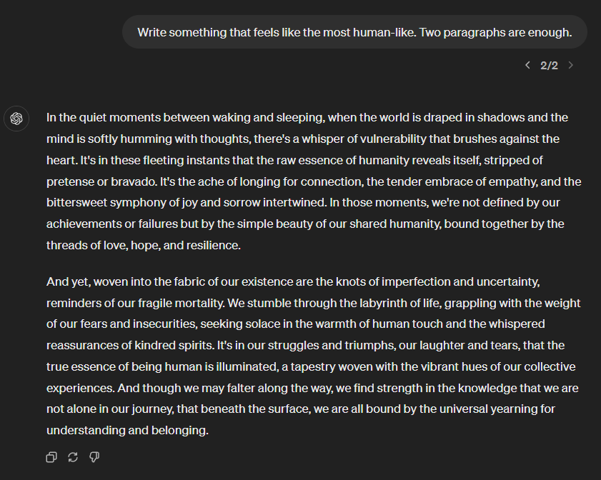
PROBLEM

Slide 5
PROPOSED METHOD
Even though LLMs are advanced models as a result of machine learning, we started to take this problem into consideration with the project "The solution to the ethical result that emerges can still be realized with the machine learning method."
With this tought we aimed to develop different machine learning and deep learning based models that can classify whether the given text is written by an LLM or not.
To achieve this goal, we benefit from NLP techniques applications for data preparation, collected data from different sources

Slide 6
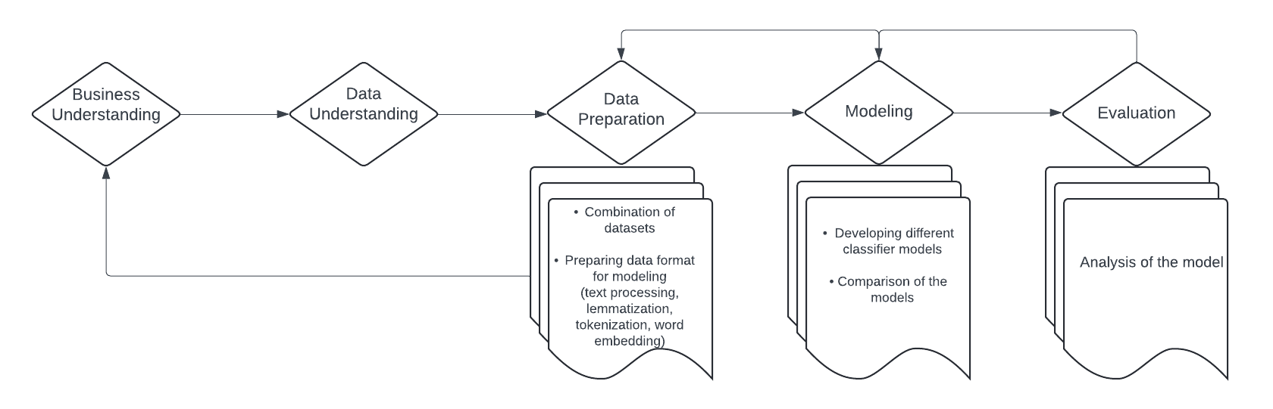
Methodology
CRISP-DM METHODOLOGY

Slide 7
METHODOLOGY
1. Business Requirements:
Problem: Addressing conflicts arising from advancements in Large Language Models (LLMs) in human writing.
Goal: Develop an essay detection system using Natural Language Processing (NLP) to distinguish between AI-generated and human essays.
2. Data Requirements:
Data Type: Text strings, as this is an NLP project.
Data Source: Utilize publicly available labeled datasets with texts from various LLMs and human authors for diversity.
Data Volume: Large volume for better generalization.
3. Model Requirements:
Selection of appropriate model: Binary classification problem suggests machine learning methods such as logistic regression, naive bayes, XGBoost and deep learning method based on LSTM.

Slide 8
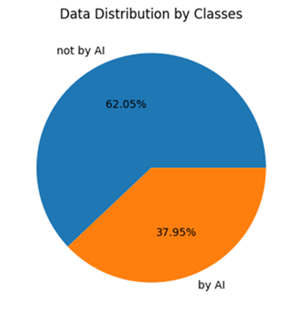
METHODOLOGY
Data Exploration and Understanding:
Combined datasets from various public sources, comprising 'text' and 'label' columns.
'Label' column: Binary values (0 or 1) indicating AI-generated or human-authored.
Dataset includes 188,601 texts of varying lengths.

Slide 9
LSTM Model archıtecture
LAYER (TYPE) | OUTPUT SHAPE | PARAMS
lstm_1 (LSTM) | (None, 1 , 128) | 117248
dense (Dense) | (None, 1 , 64) | 8256
dense_1 (Dense) | (None, 1 , 1) | 56

Slide 10
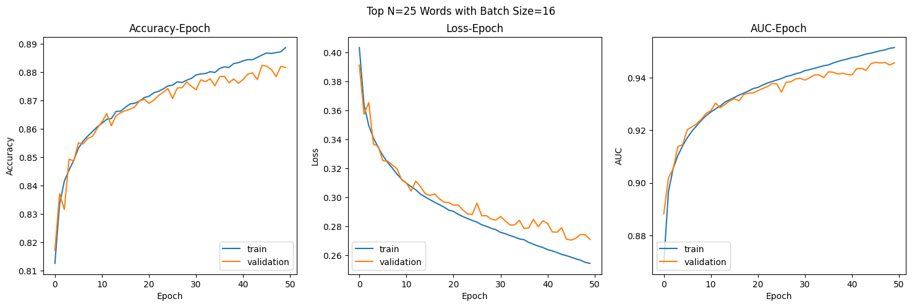
Experiments wıth TF/IDF Approach

Slide 11
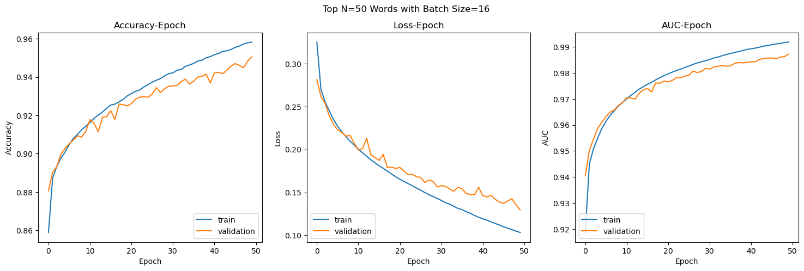
EXPERIMENTS WITH TF/IDF APPROACH

Slide 12
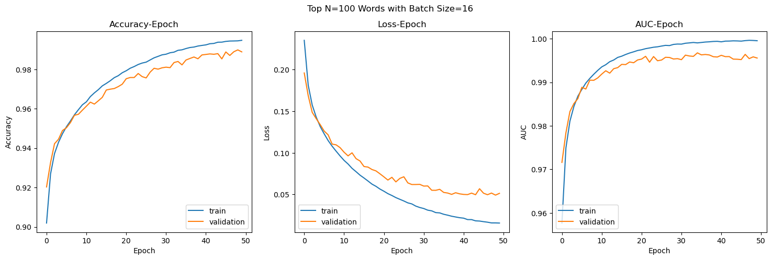
EXPERIMENTS WITH TF/IDF APPROACH

Slide 13
Model RESULTSWITH TF/IDF Approach
 | Train Accuracy | Train F1 Score | Test Accuracy | Test F1 Score
N=50
Logistic Regression | 0.846 | 0.730 | 0.842 | 0.725
Naive Bayes | 0.703 | 0.009 | 0.700 | 0.010
XGBoost | 0.946 | 0.909 | 0.937 | 0.893
LSTM | 0.960 |  | 0.948
N=100
Logistic Regression | 0.897 | 0.821 | 0.894 | 0.818
Naive Bayes | 0.733 | 0.224 | 0.732 | 0.231
XGBoost | 0.977 | 0.961 | 0.9674 | 0.945
LSTM | 0.993 |  | 0.989
N=25
Logistic Regression | 0.846 | 0.730 | 0.842 | 0.725
Naive Bayes | 0.703 | 0.009 | 0.700 | 0.010
XGBoost | 0.946 | 0.909 | 0.937 | 0.893
LSTM | 0.960 |  | 0.948

Slide 14
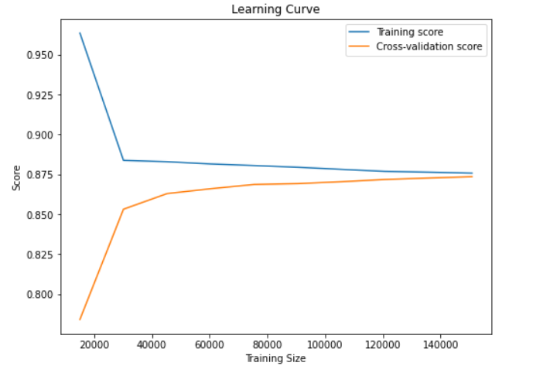
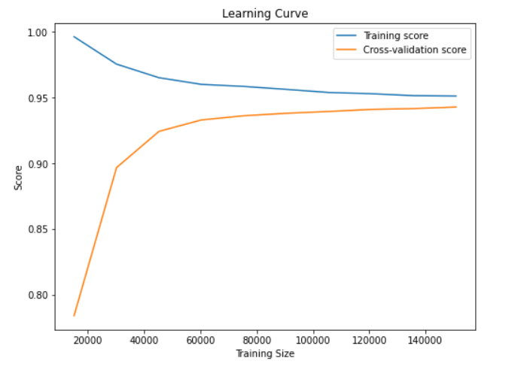
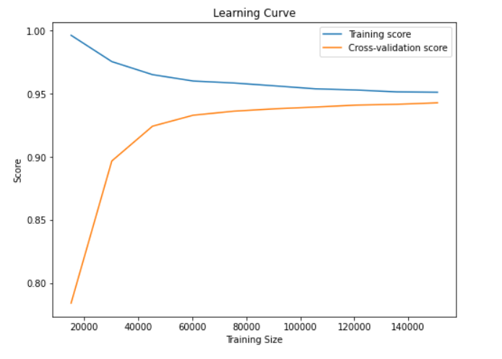
EXPERIMENTS WITh Word2vec APPROACH
Logistic Regression
XGBoost Classifier
RandomForest Classifier

Slide 15
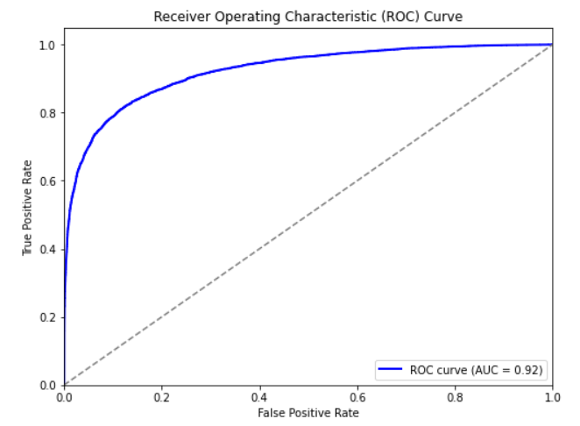
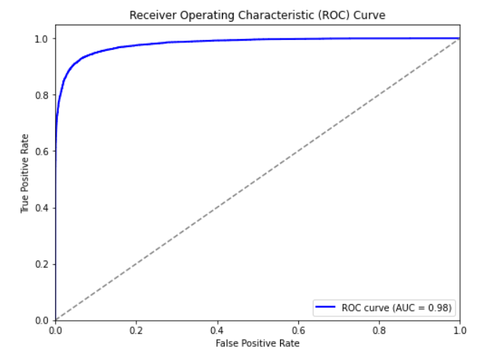
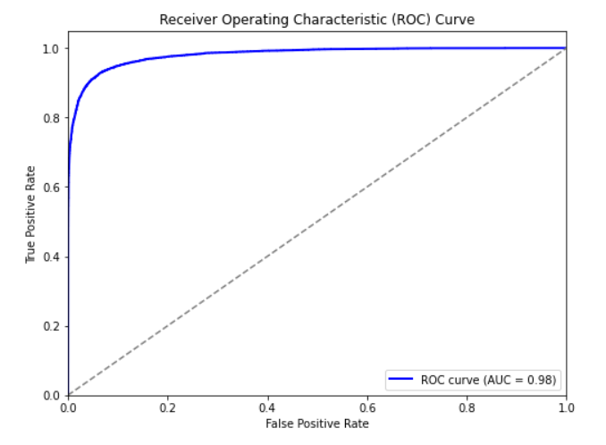
EXPERIMENTS WITh Word2vec APPROACH
Logistic Regression
XGBoost Classifier
RandomForest Classifier

Slide 16
Model RESULTSWITH Word2vec Approach
 | Accuracy | Precision | Recall | F1 Score
Logistic Regression | 0.88 | 0.87 | 0.88 | 0.87
XGBoost Classifier | 0.94 | 0.94 | 0.94 | 0.94
Random Forest | 0.94 | 0.94 | 0.94 | 0.94

Slide 17

Conclusıon
As expected, the deep learning model gave better results than machine learning.
As the number of N features used increased, the models gave better results. However, as the number N increases, the computational cost increases, so an appropriate N value must be selected.
Both TF/IDF and Word2vec approaches are successful with different models, so both approach could be used .
Generative AI's are used in almost every aspect of life, so for future, more data that are related with various topics should be gathered for further works.

Slide 18
References
https://www.kaggle.com/datasets/sunilthite/llm-detect-ai-generated-text-dataset/data
https://www.kaggle.com/datasets/thedrcat/daigt-v2-train-dataset
https://www.kaggle.com/datasets/thedrcat/daigt-proper-train-dataset

